Slide 1
Where’s Wally?

Slide 2
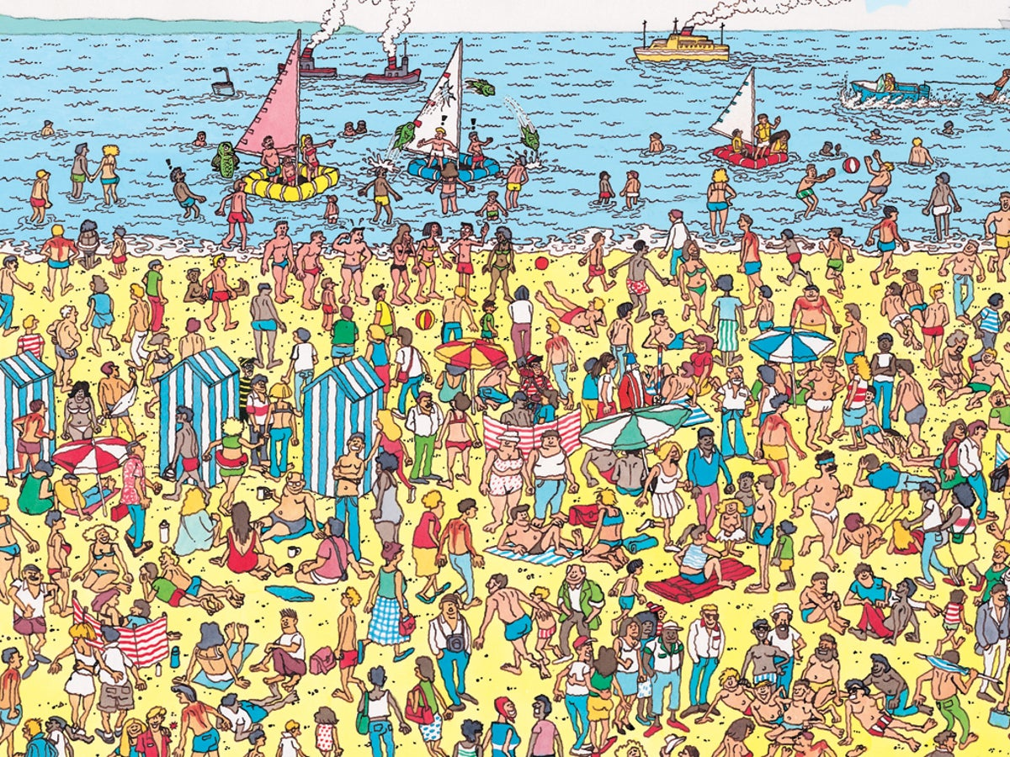

Slide 3
How?
Put img and div together
If user click the div, I can alert of success
When clicking others, showing message of failing
Languages?
HTML
CSS
JavaScript – some APIs?

Slide 4
Details
From level 1 to level 5?
Increasing level, finding Wally will be difficult because there will be lots of people.
Increasing level, time will be reduced.
https://laughtonallsaints.org/storage/app/media/uploaded-files/wheres%20wally.pdf

Slide 5
Level 01
00:59
♦

Slide 6
Level 01
00:59
❌

Slide 7
WIN !

